Slide 1
A comparative perspective:
Convergence, integration and spillovers
Robert Stehrer
The Vienna Institute for International Economic Studies – wiiw
Rahlgasse 3, A-1060 Vienna
www.wiiw.ac.at
Productivity: A challenge to the Slovenian economy
14 June 2017, Ljubljana, Slovenia.

Slide 2
Overview
EU-CEE convergence process
EU specialisation patterns
Spillovers matter

Slide 3
GDP per capita at PPP, 2016, EU28=100
Sources: wiiw Annual Database incorporating national and Eurostat statistics, wiiw estimates, Eurostat, EC - Winter Report 2017.

Slide 4
GDP per capita at PPP, EU28=100
Sources: wiiw Annual Database incorporating national and Eurostat statistics, wiiw estimates, Eurostat, EC - Winter Report 2017.

Slide 5
GDP per capita at PPP, 1991=1
Sources: wiiw Annual Database incorporating national and Eurostat statistics, wiiw estimates, Eurostat, EC - Winter Report 2017.

Slide 6
Convergence process derailed?
2000-2007
2012-2016
Sources: wiiw Annual Database incorporating national and Eurostat statistics, wiiw estimates, Eurostat, EC - Winter Report 2017.

Slide 7
Convergence process derailed?
2009-2016
2010-2016
2011-2016
2012-2016
2013-2016
2014-2016
Sources: wiiw Annual Database incorporating national and Eurostat statistics, wiiw estimates, Eurostat, EC - Winter Report 2017.

Slide 8
Convergence process derailed?
  Macro-economic turbulences
  Conditional convergence
  Middle-income trap

Slide 9
Role of productivity driving industries
  Manufacturing
  Business services
European patterns of specialisation and spillovers

Slide 10
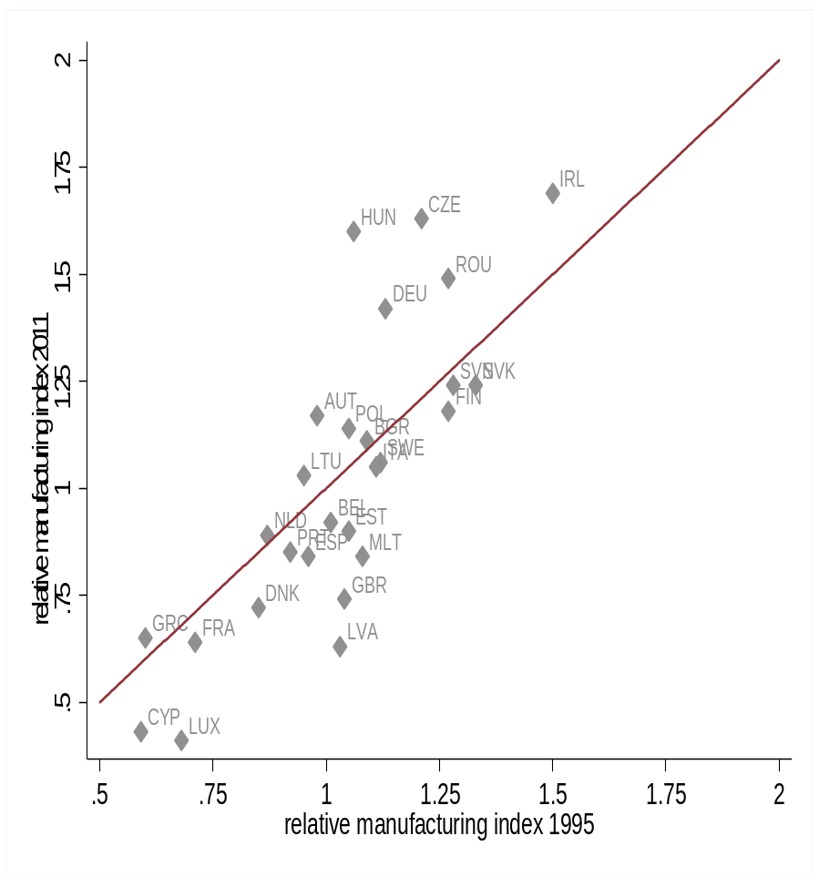
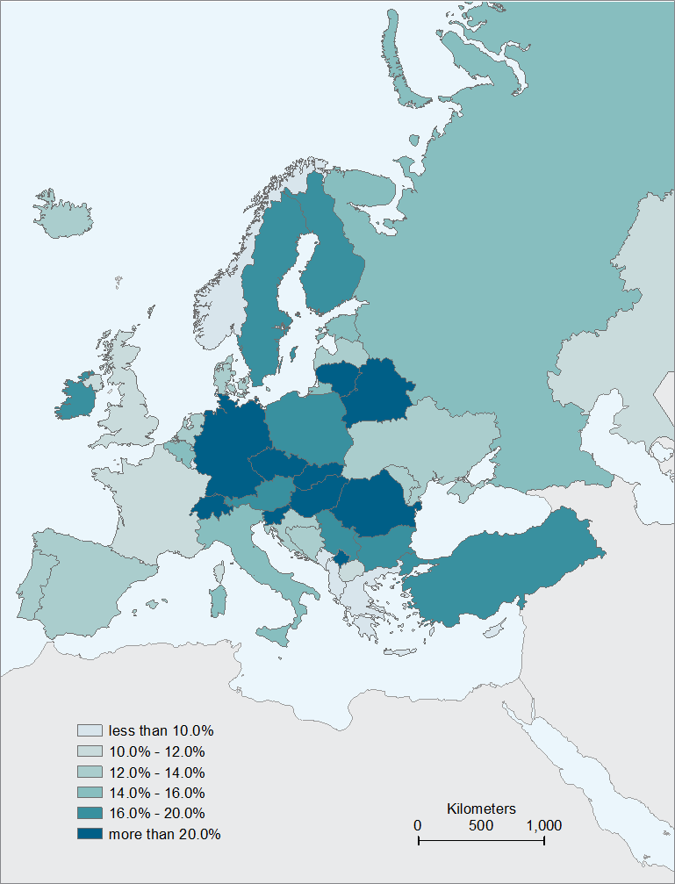
Central European Manufacturing Core
Slovenia
Source: wiiw Handbook, 2014
Source: WIOD, wiiw-calculations (FIW Research Report 2014: The Central European Manufacturing Core)
Note: The relative manufacturing specialisation index is the ratio of Member State’ share in EU wide manufacturing value added over their share in EU GDP. A higher index value indicates stronger specialisation in manufacturing.

Slide 11
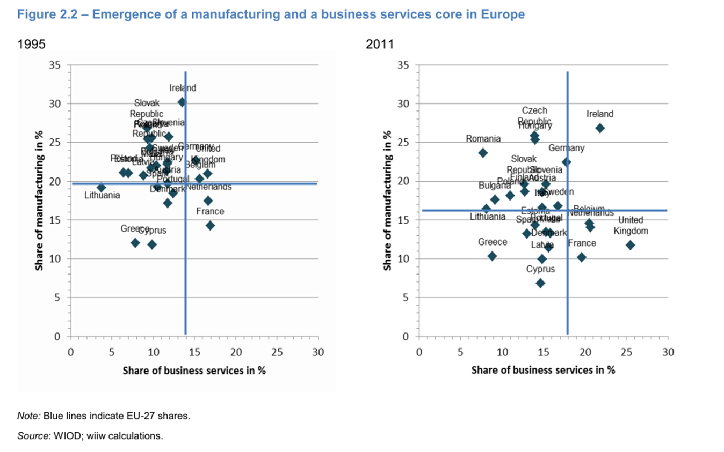
Specialisation dynamics across Europe
Source: Stehrer et al. (2014), Study on the relation between industry and services in terms of productivity and value creation, Study for the Directorate-General for Enterprise and Industry, 2nd interim report.

Slide 12
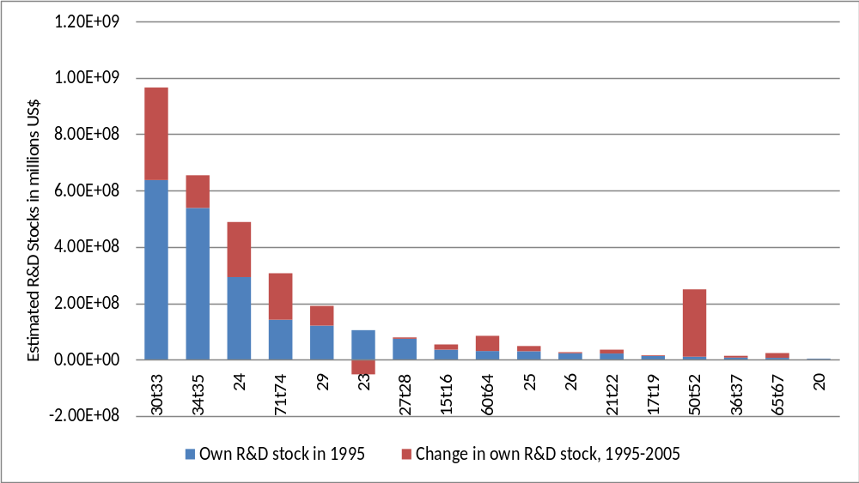
R&D Stocks by Sector of Countries Covered in the OECD ANBERD Dataset

Slide 13
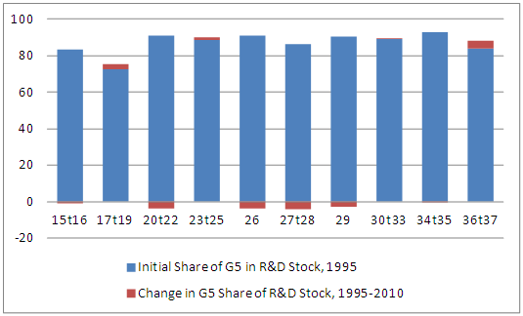
Share of G5 in domestic R&D stock by industry
(in % of total R&D expenditures of ANBERD)
G5: DEU, FRA, GBR, JPN, USA,

Slide 14
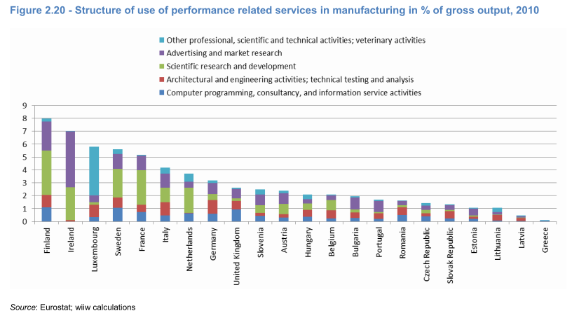
Role of business services
(Use of BS in manufacturing in % of gross output; NACE Rev. 2 classification
Source: Stehrer et al. (2014), Study on the relation between industry and services in terms of productivity and value creation, Study for the Directorate-General for Enterprise and Industry, Final report..

Slide 15
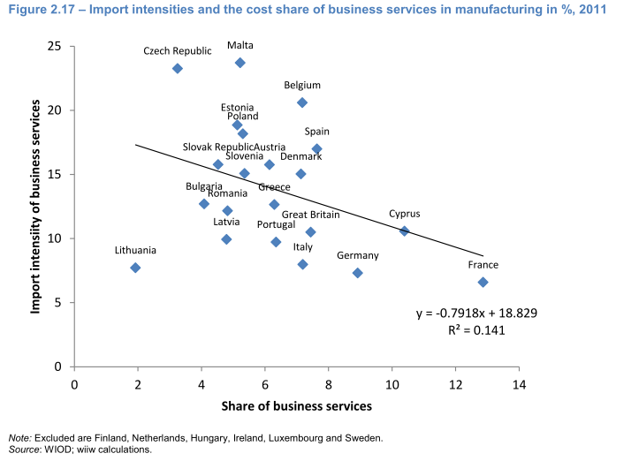
Source: Stehrer et al. (2014), Study on the relation between industry and services in terms of productivity and value creation, Study for the Directorate-General for Enterprise and Industry, Final report..

Slide 16
Spillover effects matter
Integration into EU-VCs had positive impacts on growth and productivity
Productivity and R&D spillovers have contributed significantly to productivity growth in CEECs
Positive impacts on productivity growth from imported business services
Impact of spillover also dependent on absorptive capacities of countries

Slide 17
Conclusions
Convergence process derailed but maybe re-emerging (but less strong)
Position in European (Global) value chain and division of labour matters (e.g. EU manufacturing core)
Spillover effects from international integration matter
‚Allocative efficiency‘ must be seen
  in an international context (position in value chains and upgrading potentials)
  as a dynamic concept (technology and knowledge upgrading, patterns of specialisation)

