Slide 1
Enhancing Productivity Performance, Ireland’s Policy Approach
            IMAD Seminar on Productivity
            June 14th 2017
John Maher, National Competitiveness Council, Ireland

Slide 2
National Competitiveness Council Role & Purpose
As a small open economy, Ireland’s ability to achieve sustainable growth is dependent on our ability to maintain international competitiveness.
The National Competitiveness Council (NCC) is an independent body reports to and advises the Taoiseach (Prime Minister) and the Government on key competitiveness issues facing the Irish economy and offers recommendations on policy actions required to enhance Ireland’s competitive position. It was established by Government in 1997.
The Council takes a broad definition of competitiveness which reflects international best practice as its focus is on both productivity and costs and it also takes account of Ireland’s position as a Small Open Economy. The interaction between productivity and costs matters for relative global attractiveness of a location and for macroeconomic sustainability.
“Ireland’s national competitiveness refers to the ability of the enterprise base in Ireland to compete in international markets”. Ireland’s productivity is considered the primary determinant of its competitiveness relative to other countries.

Slide 3
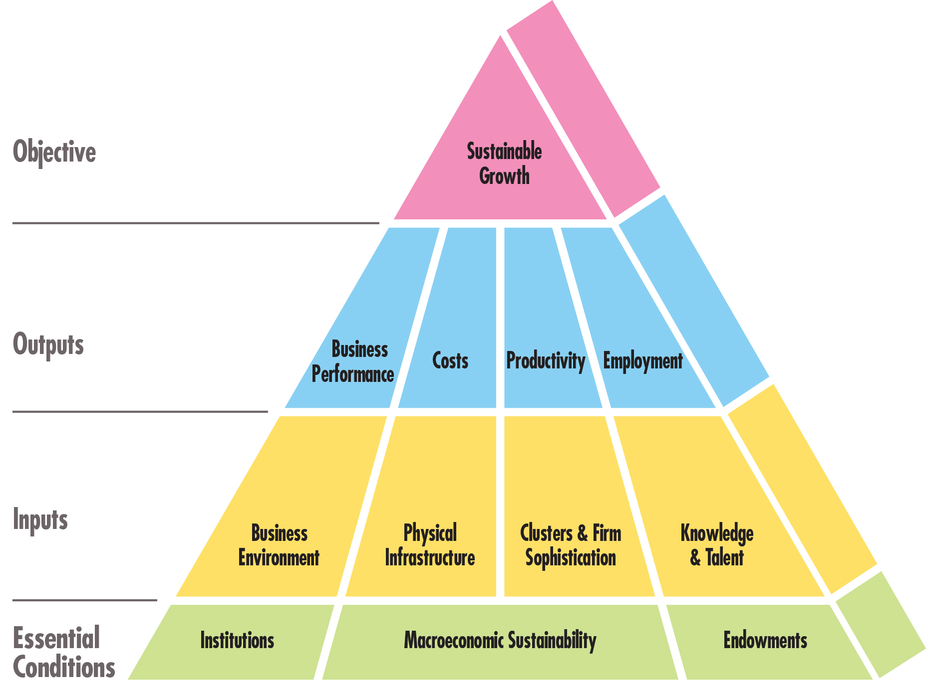
NCC Definition of Competitiveness
Source: NCC

Slide 4
Labour Productivity Performance

Slide 5
Irish Sectoral Productivity Growth
Source: OECD/NCC calculations

Slide 6
Summary of NCC Key Findings on Productivity
Starting from a low base, productivity levels and growth rates now exceed those of many of our key competitors.
Despite the severity of the economic crisis the trajectory of Ireland’s productivity performance is relatively strong in an international context
Ireland’s productivity performance is however built upon a narrow base of sectors, and indeed, in some cases, firms
Examining the value added component of economic activity in Ireland shows that high value added sectors such as ICT and chemicals serves to boost Ireland’s productivity and disguises to a degree underperforming sectors and firms
Policy must be ambitious, focus attention on multiple levers at national level which can, over time, enhance the capability of firms and individuals to effect change and boost productivity
Data issues and further research….

Slide 7
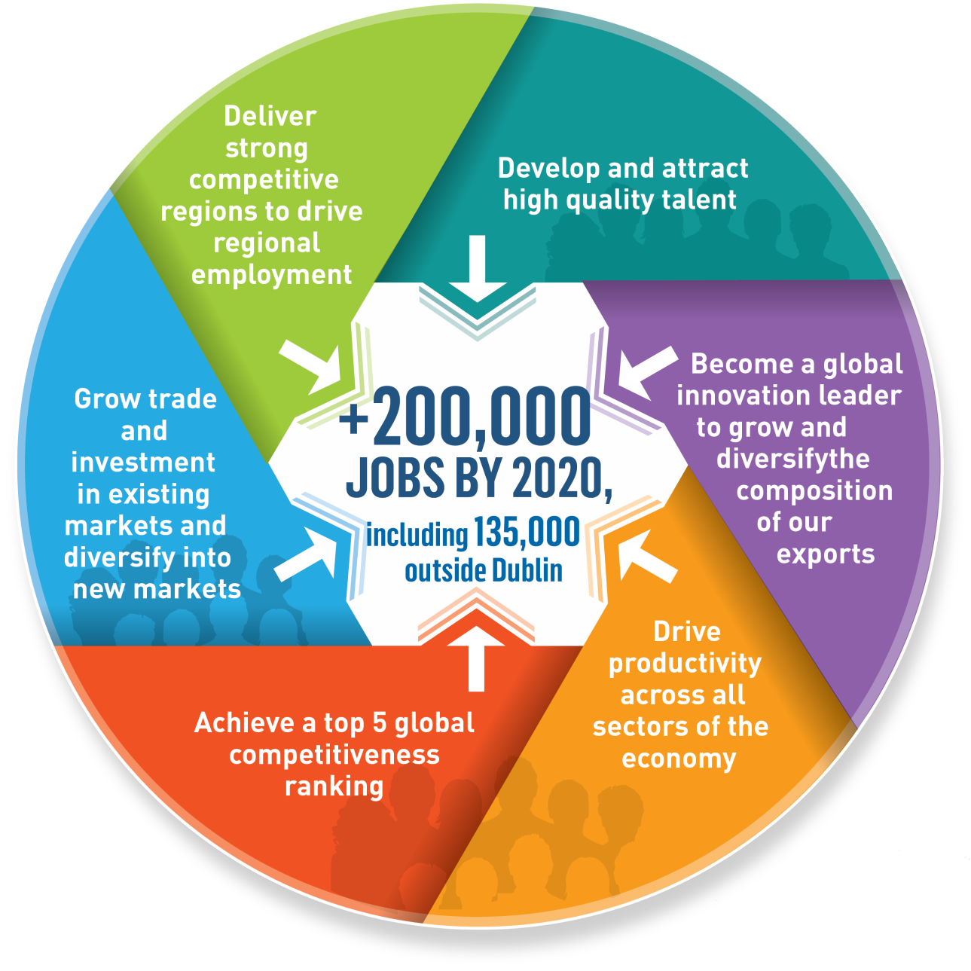
Policy Response-Embedding productivity into Industrial Policy – Enterprise 2025
Source: DJEI

Slide 8
EP 2025 Strategy
Build Resilience
Across a range of sectors
Pursue new opportunities
Build supportive ecosystems
Drive a step change in enterprise performance
Differentiate what Ireland has to offer
Talent
Place-making
Innovativeness
Connectedness
Excel at getting the basics right
Finance for growth
Taxation
Cost competitiveness
Physical and Knowledge Infrastructures

Slide 9



Spearheading Policy Implementation
Department of Jobs, Enterprise & Innovation
S
Supporting Indigenous Irish Companies
Supporting Research
and Innovation
for the Future
Supporting Multinational Companies in Ireland

Slide 10
Thank You
For more information see: www.competitiveness.ie
john.maher@djei.ie

