Slide 1
Tax reforms in EU Member States Overview of International Experience
Frank Van Driessche
DG Taxation and Customs Union
June 2013

Slide 2
Content of the presentation
Trends in tax policy: a brief overview
Trends in tax administration: selected issues
Recent EU initiatives: an update

Slide 3
Tax revenues are increasing … in relation to GDP Total tax revenues as % of GDP
%
Source: Taxation trends in the European Union 2013 edition

Slide 4
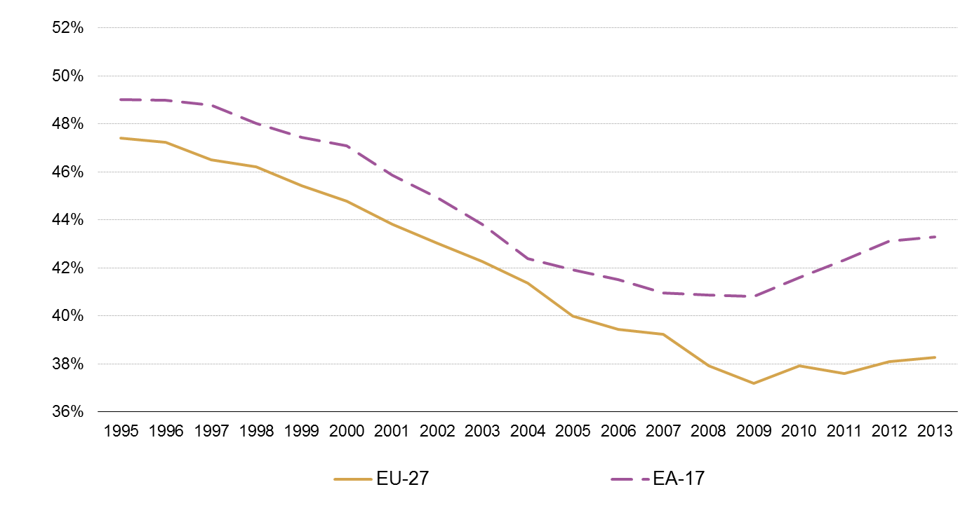
Top personal income tax rates are at their highest level since 2008
%
Source: Taxation trends in the European Union 2013 edition

Slide 5
The steep drop in corporate tax rates has levelled off
Source: Taxation trends in the European Union 2013 edition

Slide 6
VAT standard rates continue to rise
Source: Taxation trends in the European Union 2013 edition

Slide 7
Main trends:
• Revenues
- After the sharp decline in 2009, figures for 2011 show tax
revenues have started to rise again.
• Rates
- VAT rates have increased strongly over the last four years.
- Top personal income tax rates have risen to pre-crisis level.
- Corporate income tax rates have levelled off.
• Tax shift
- Growth-friendly taxation: Increase in consumption taxes,
small drop in labour taxes.

Slide 8
Trend in VAT GAP – 2000/2011- EU 27(*)
%
(*) Except CY
Source: PCB and Case 2013-provisonal data

Slide 9
Tax administration: selected issues
Institutional and organisational reforms.
Strategies aimed at fostering voluntary compliance.
Modernisation of debt collection.
Performance management.
Increasing use of modern electronic service delivery.
An increasing challenge to tackle VAT fraud.
Inter-agency cooperation.

Slide 10
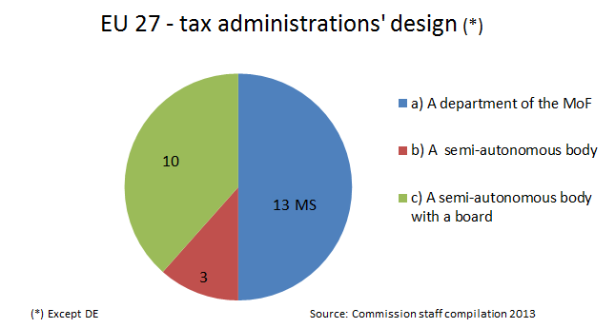
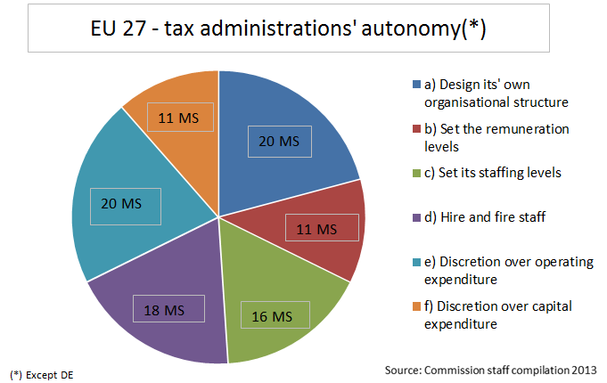
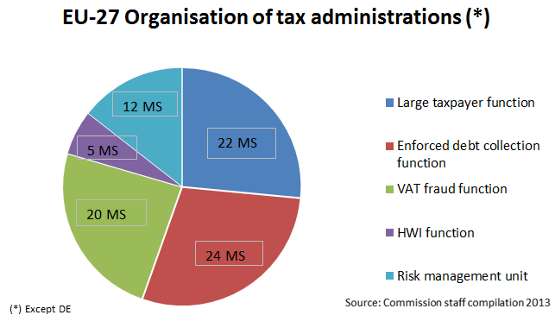
Institutional and organisational reforms
Increased autonomy
Centralisation of management
Taxpayer segment-based structures

Slide 11
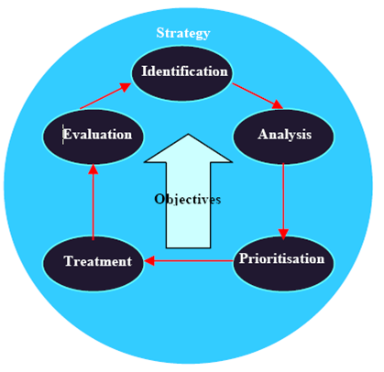
Fostering voluntary compliance
Building Trust – Transparency – Legal certainty
Enhanced compliance risk management.
Taxpayer segmentation; e.g.
Large taxpayers.
High Wealth Individuals.
High Income Self-Employed.
Treatment mix; e.g.
Communication.
Responsive regulation.

Slide 12
Debt Collection
Average tax debt levels in OECD countries continued to ease in 2011, following their peak in 2009 (i.e. year following the global financial crisis).
Nevertheless there are significant increases in a number of countries.

Slide 13
Stock of VAT debt at the end of the year in percentage of annual VAT revenue (growth).

Slide 14
Main trends in debt collection
Non-sequential debt collection processes
Communication with debtors: e.g. outbound call centers
Integrated recovery process supported by automated identification of assets based on third party information
Merger of collection of taxes and SCC's.

Slide 15
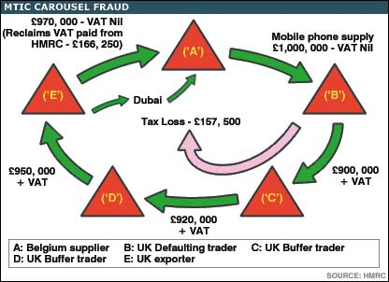
Tackling VAT fraud
"Reverse charge"
Quick reaction mechanism.
Optional application of VAT reverse charge.
Proactive measures
Preventive measures at the pre-registration stage.
Post-registration monitoring.
Intelligence to detect missing traders at early stage.
De-registration of VAT Numbers.
EUROFISC.

Slide 16
A whole of government approach
Reinforced cooperation with other law enforcement bodies:
Police.
Justice.
Social security authorities.
Anti-money laundering auth.

Slide 17
Recent initiatives to combat tax fraud and evasion at European level
In December 2012, the Commission adopted a Communication containing an action plan to combat tax fraud and evasion at European Level
A yearly circle of economic policy coordination called "European Semester".
What gets measured gets managed; an EU-wide bench-marking for VAT.

Slide 18
Thank you for your attention.
Contact: frank.van-driessche@ec.europa.eu

