Slide 1
Fiscal Consolidation and Structural Reforms in OECD Countries
International Conference organized by the Institute of Macroeconomic Analysis and Development –
Managing Macroeconomic Imbalances
19 June 2012, Ljubljana
Rafal Kierzenkowski
OECD, Economics Department, Head of Slovenia desk

Slide 2
Outline
Economic outlook
The size of the fiscal challenge
Growth-friendly consolidation instruments
Structural reforms (labour and product market)
Key challenges facing Slovenia to restart growth
Outline

Slide 3
Economic outlook
Outline
3

Slide 4
The outlook for OECD countries
Real GDP growth, in per cent
 | 2010 | 2011 | 2012 | 2013
United States | 3.0 | 1.7 | 2.4 | 2.6
Euro area | 1.9 | 1.5 | -0.1 | 0.9
Japan | 4.5 | -0.7 | 2.0 | 1.5
Total OECD | 3.2 | 1.8 | 1.6 | 2.2
Source: OECD Economic Outlook 91 database.
Economic outlook
4
Notes:
4

Slide 5
World growth sustained by emerging economies
Contribution to annualised quarterly world real GDP growth, percentage points
Note: Calculated using moving nominal GDP weights, based on national GDP at purchasing power parities.
Source: OECD Economic Outlook 91 database.
Economic outlook
5
Notes:
5

Slide 6
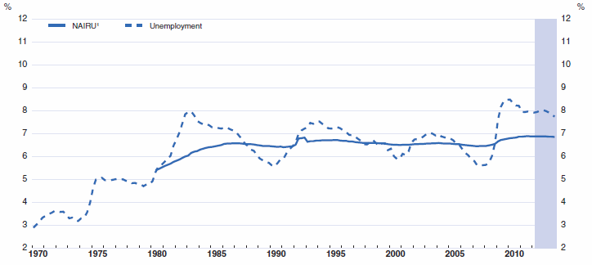
High labour market slack is set to persist…
Unemployment and estimated NAIRU in the OECD area
1. NAIRU is based on OECD estimates. For the United States, it has not been adjusted for the effect of extended unemployment benefit duration.
Source: OECD Economic Outlook 91 database.
Economic outlook
6
Notes:
6

Slide 7
…but jobless rates are diverging in key regions
Unemployment rate, percentage of labour force
Source: OECD Economic Outlook 91 database.
Economic outlook
7
Notes:
7

Slide 8
Business confidence is uneven
Purchasing Managers Index (PMI) for manufacturing and services
Note: Values greater than 50 signify an improvement in economic activity.
Source: Markit Economics Limited.
Economic outlook
8
Notes:
8

Slide 9
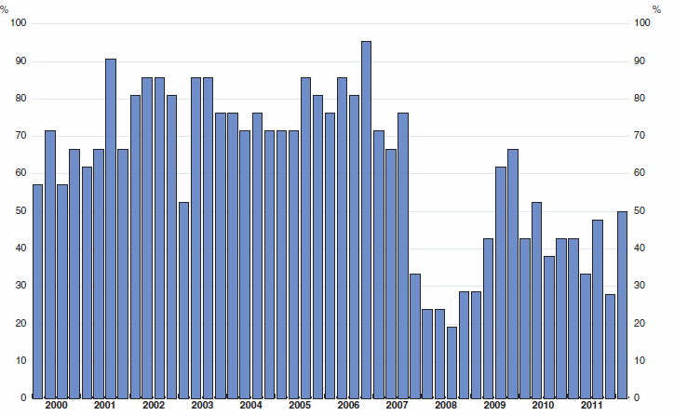
Real house prices are falling in many countries
Proportion of countries with rising house prices, based on quarterly changes
Note: House prices deflated by the private consumption deflator, published and forecasted. Calculation based on 21 countries (18 in 2011q4 and 10 available in 2012q1)
Source: National sources.
Economic outlook
9
Notes:
9

Slide 10
Deleveraging has barely begun in the euro area
Household gross debt, percentage of net disposable income
Note: Data for USA and Japan are not consolidated. For 2011 Q3 data are growth rates (2010 end of year to 2011 Q3) of balance sheets published by US Federal Reserve, Bank of Japan, and ECB. Euro area 3 is Germany, France and Italy.
Source: OECD Annual National Accounts.
Economic outlook
10
Notes:
10

Slide 11
Underlying inflation is likely to remain moderate
Core inflation, 4-quarter percentage change
Note: United States - deflator of personal consumption expenditures (PCE) excluding food and energy; Euro area - harmonised index of consumer prices (HICP) excluding food, energy, tobacco and alcohol; Japan - consumer price index (CPI) excluding food and energy. Source: OECD Economic Outlook 91 database.
Economic outlook
11
Notes:
11

Slide 12
Monetary policy rates remain ultra low
Policy interest rates, in per cent
Source: Datastream.
Economic outlook
12
Notes:
12

Slide 13
Central banks have expanded asset purchases
Central bank liabilities, local currency
Source: Federal Reserve; Bank of Japan; and European Central Bank.
Economic outlook
13
Notes:
13

Slide 14
The size of the fiscal challenge
Outline
14

Slide 15
Public gross debt has risen to high levels
Source: OECD Economic Outlook 90 Database.
Fiscal challenge
15
Notes:
15

Slide 16
Fiscal consolidation mix
Change in the underlying primary balance 2011-13,
in per cent of potential GDP
Note: Total consolidation is the projected difference in the underlying primary balance; revenue side is the projected increase in the underlying receipts excluding interest earned on financial assets; and spending side is the projected decline in the underlying primary spending excluding interest payments on debt.
Source: OECD Economic Outlook 91 database; and OECD calculations.
Fiscal challenge
16
Notes:
16

Slide 17
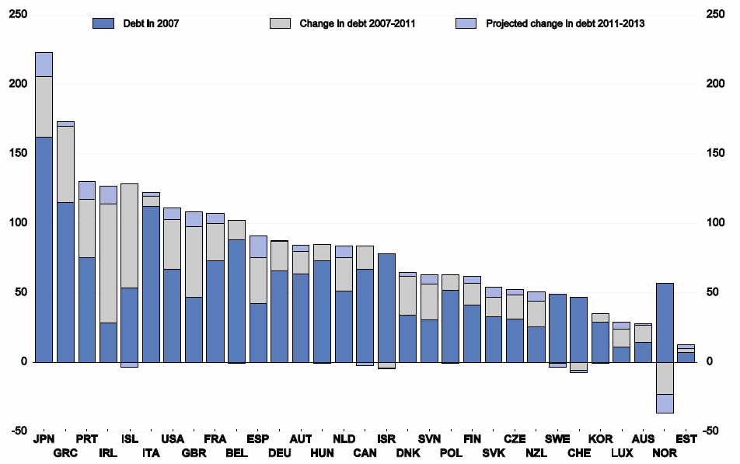
Government debt accumulation is slowing
Government gross financial liabilities, per cent of GDP
Note: Change in debt includes cumulated deficit for 2007-11 and 2011-13, debt-increasing equity participation in companies and the impact of GDP growth. For Norway cumulated deficits correspond to mainland only.
Source: OECD Economic Outlook 91 database.
Fiscal challenge
17
Notes:
17

Slide 18
Public debt sustainability remains a LT challenge
Fiscal gaps from 2013 for debt to reach 50% of GDP by 2050
Note: “Low” health assumes policy action curbs health spending growth. “High” health is the additional cost pressure in the absence of these policy actions.
Source: OECD calculations.
Fiscal challenge
18
Notes:
18

Slide 19
Growth-friendly consolidation instruments
Outline
19

Slide 20
Why consolidate?
Short-term considerations:
- Reduce borrowing costs
- Insure against rollover risks
- Reap non-Keynesian effects
Long-term considerations:
- Limit negative effects of public debt on long-term growth
- Reduce future costs of population ageing
- Respect other policy objectives, such as:
        Raising public sector efficiency
        Eliminating wasteful spending
        Raising taxes on negatives externalities
        Reconsider tax expenditures
Growth-friendly consolidation
20
Notes:
20

Slide 21
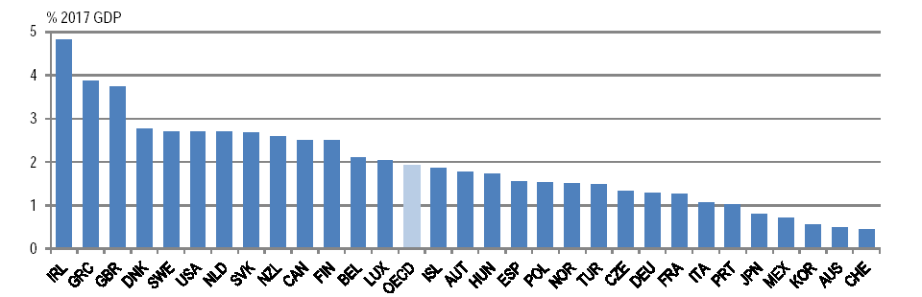
Improve health care efficiency
Budgetary savings from improved efficiency in health care systems
Note: Potential savings represent the difference between a no-reform scenario and a scenario where countries would exploit efficiency gains. The no-reform scenario assumes that between 2007 and 2017 life expectancy and spending increase at the same pace as over the previous 10 years and that the mix between public and private spending remains constant over time.
Source: Joumard, I., P. Hoeller, C. André and C. Nicq (2010), Health Care Systems: Efficiency and Policy Settings.
Growth-friendly consolidation
21
Notes:
21

Slide 22
Boost education efficiency
Budgetary savings from improved efficiency in primary and secondary education
Source: Sutherland et al. (2007)
Growth-friendly consolidation
22
Notes:
22

Slide 23
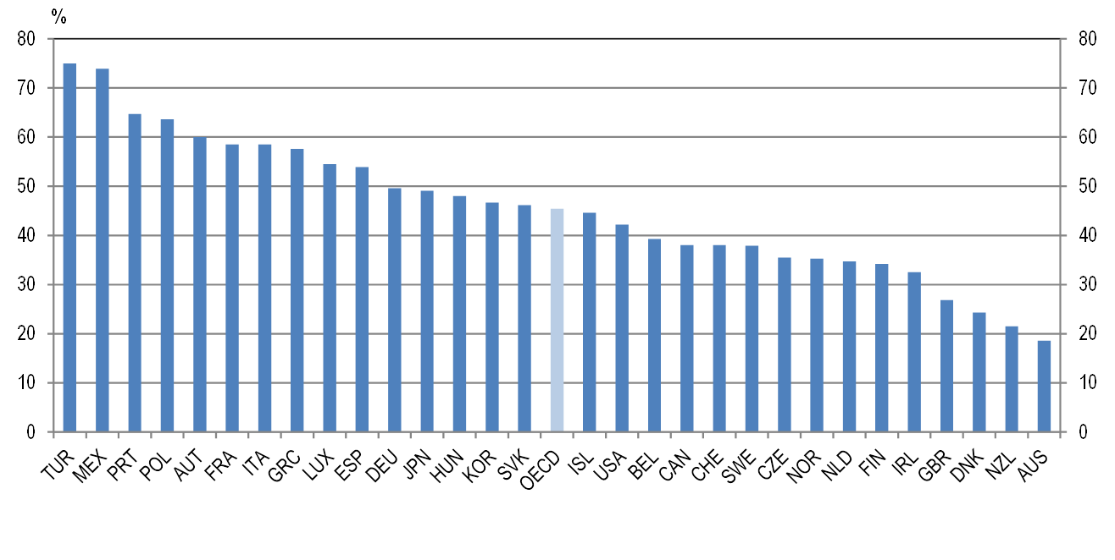
Better target social spending
Share of social transfers received by the top half of the population in 2005
Source: Whiteford, P. (2009), “Transfer Issues and Directions for Reform: Australian Transfer Policy in Comparative Perspective,” Paper presented for Australia’s Future Tax and Transfer Policy Conference, Department of the Treasury and Melbourne Institute of Applied Economic and Social Research, Melbourne, 18-19 June.
Growth-friendly consolidation
23
Notes:
23

Slide 24
Shift to less distortionary taxation
Recurrent tax revenues from immovable property, 2009
Source: OECD Revenue Statistics database.
Growth-friendly consolidation
24
Notes:
24

Slide 25
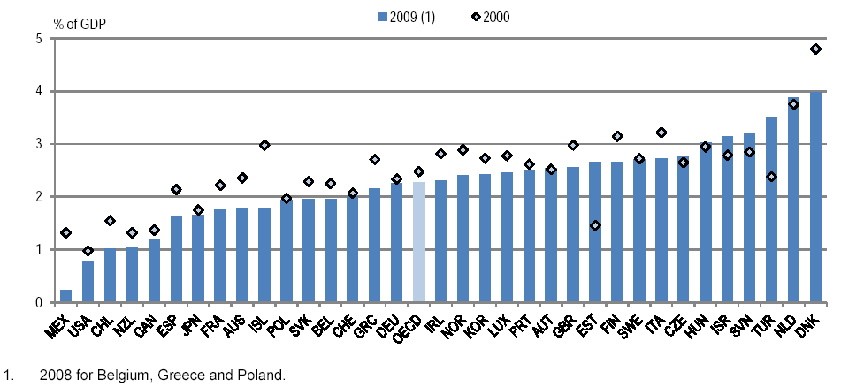
Increase environmental tax revenues
Source: OECD Revenue Statistics database.
Source: OECD/EEA database on instruments used for environmental policy and natural resources management.
Growth-friendly consolidation
25
Notes:
25

Slide 26
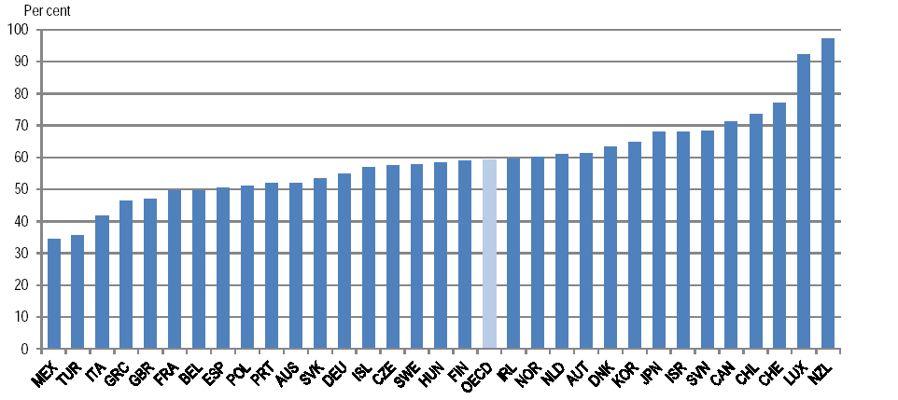
Foster value added tax performance
The VAT revenue ratio, average 2007-08
Note: The VAT revenue ratio measures the difference between the VAT revenue actually collected and what would theoretically be raised if VAT was applied at the standard rate to the entire potential tax base in a “pure” VAT regime and all revenue was collected: The VAT revenue ratio equals VAT Revenue/(Consumption * Standard VAT rate)*100.
Source: OECD (2011), Consumption Tax Trends 2010: VAT/GST and Excise Rates, Trends and Administration Issues.
Growth-friendly consolidation
26
Notes:
26

Slide 27
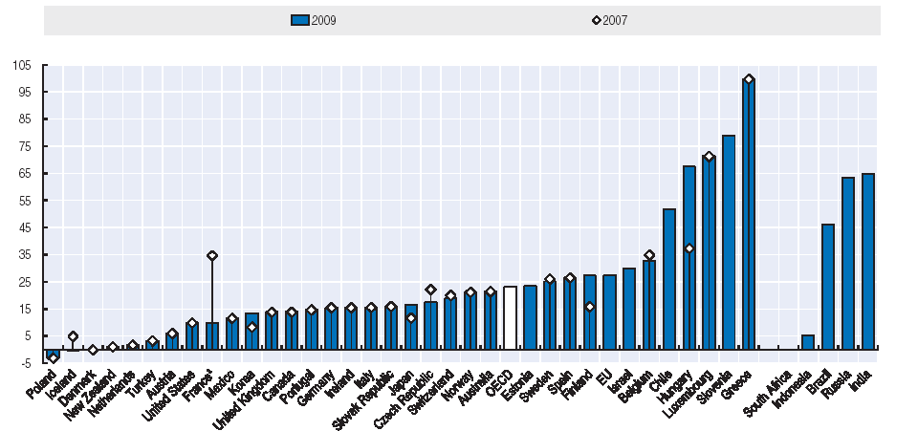
Continue pension reforms
Implicit taxes on continued work at older ages versus pension up-take, % average worker earnings
Source: OECD calculations.
Growth-friendly consolidation
27
Notes:
27

Slide 28
Structural reforms (labour and product market)
Outline
28

Slide 29
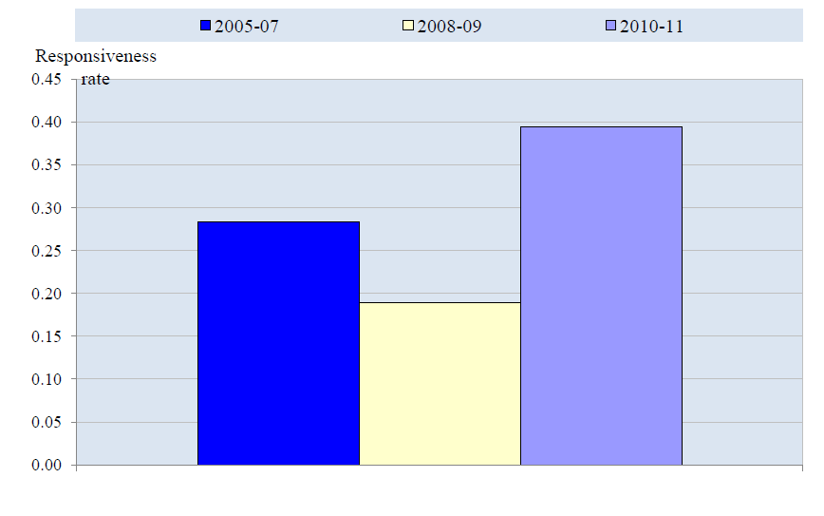
The crisis has acted as a catalyst for reforms
Responsiveness to Going for Growth recommendations across the OECD, 2005-2011
Note: The responsiveness rate is based on a scoring system in which each priority set in the previous edition of Going for Growth rakes a value of one if "significant" action is taken the following year, and zero if not. Average across OECD countries excluding Chile, Estonia, Israel and Slovenia.
Structural reforms
29
Notes:
29

Slide 30
Reform progress greater in low-income countries
Note: The indicator is the ratio of the total number of years in which some action is taken to address the policy priority to the total number of years in which the policy priority has been identified.
Source: OECD Going for Growth 2012.
Structural reforms
30
Notes:
30

Slide 31
Reform implementation and fiscal stance
Overall responsiveness to Going for Growth priorities and consolidation effort
Source: OECD Economic Outlook 90 Database (for fiscal consolidation projections).
Structural reforms
31
Notes:
31

Slide 32
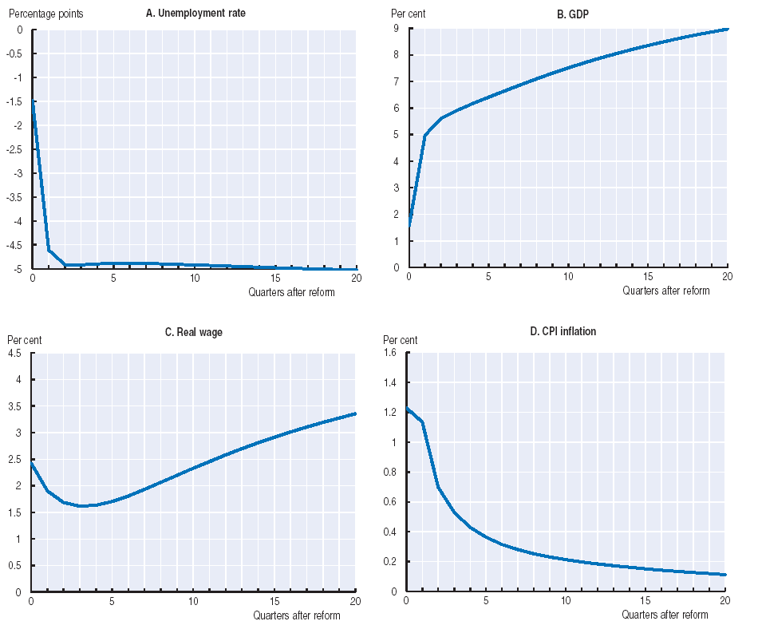
Reform packages can have short-term benefits
A package combining a decline in entry barriers, a reduction in unemployment benefit replacement rate and a relaxation of job protection in a “rigid” economy
Source: Cacciatore, M., R. Duval and G. Fiori (2012), “Short-term Pain or Gain? A DSGE Model-based Analysis of the Short-term Effects of Structural Reforms in Labour and Product Markets”, OECD Economics Department Working Papers, forthcoming.
Structural reforms
32
Notes:
32

Slide 33
Unemployment benefit reforms
Such reforms can have a fairly quick positive impact on labour utilisation
A. Change in aggregate employment rate following a "typical" reduction in initial unemployment benefit replacement rate
B. Change in youth unemployment rate following a "typical" reduction in unemployment benefit duration
Note: *** and ** represent statistical significance at the 1 and 5% levels, respectively. The simulation is based on the median-sized reform observed in the estimation sample. In Panel B, the impact of the reform is estimated controlling for the initial unemployment benefit replacement rate.
Source: Bouis, R. et al. (2012), “The Short-term Effects of Structural Reforms: an Empirical Analysis”, OECD Economics Department Working Papers.
Structural reforms
33
Notes:
33

Slide 34
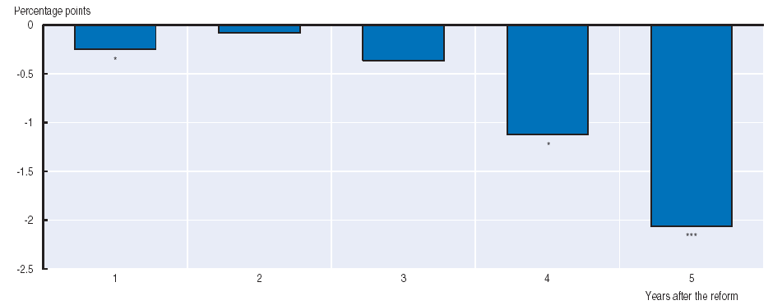
Reforms of job protection
Change in aggregate employment following a “typical” reduction in job protection on temporary contracts
Note: *** and * represent statistical significance at the 1 and 10% levels, respectively. The simulation is based on the median-sized reform observed in the estimation sample.
Source: Bouis, R. et al. (2012), “The Short-term Effects of Structural Reforms: an Empirical Analysis”, OECD Economics Department Working Papers.
Structural reforms
34
Notes:
34

Slide 35
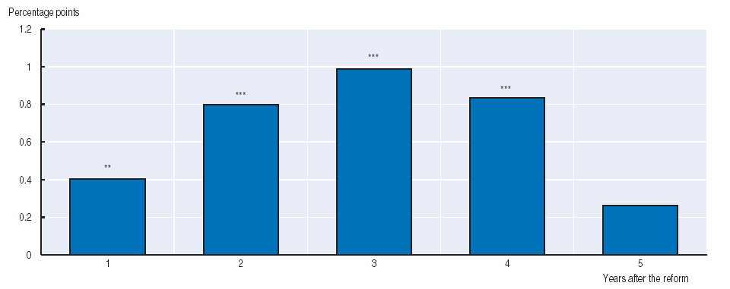
Active labour market policies
Change in aggregate employment following a “typical” increase in public spending on ALMP employment incentives
Note: *** and ** represent statistical significance at the 1 and 5% levels, respectively. The simulation is based on the median-sized reform observed in the estimation sample.
Source: Bouis, R. et al. (2012), “The Short-term Effects of Structural Reforms: an Empirical Analysis”, OECD Economics Department Working Papers.
Structural reforms
35
Notes:
35

Slide 36
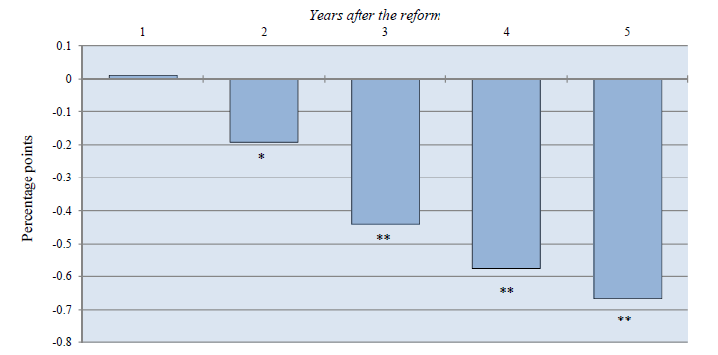
Administrative extensions of collective agreements
Change in female unemployment following a decline in excess bargaining coverage
Note: ** and * represent statistical significance at the 5 and 10% levels, respectively. The simulation is based on the median-sized reform observed in the estimation sample.
Source: Bouis, R. et al. (2012), “The Short-term Effects of Structural Reforms: an Empirical Analysis”, OECD Economics Department Working Papers.
Structural reforms
36
Notes:
36

Slide 37
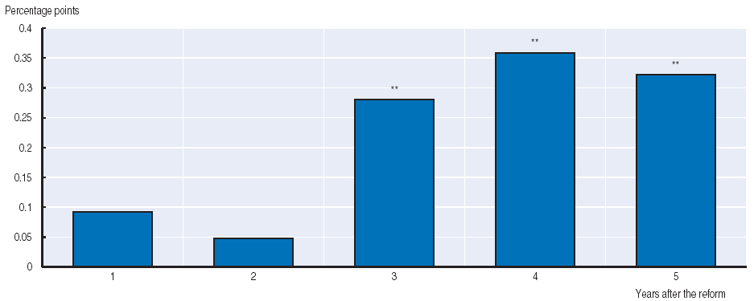
Product market reforms
Change in aggregate labour force participation following a “typical” product market reform
Note: ** represents statistical significance at the 5% level. The simulation is based on the median-sized reform observed in the estimation sample.
Source: Bouis, R. et al. (2012), “The Short-term Effects of Structural Reforms: an Empirical Analysis”, OECD Economics Department Working Papers.
Structural reforms
37
Notes:
37

Slide 38
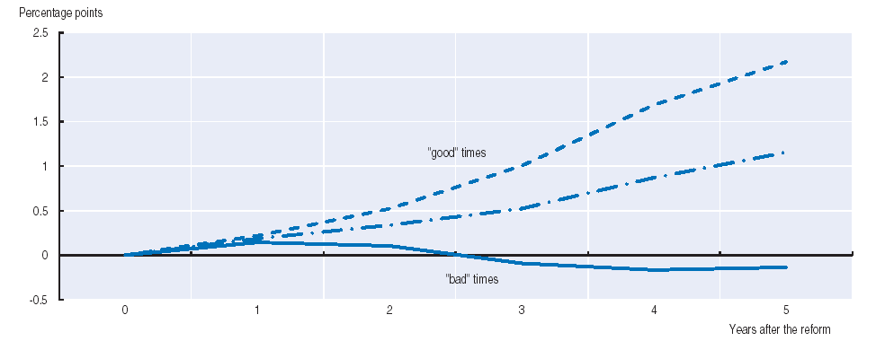
The cycle is important
Change in aggregate employment following a “typical” reduction in initial unemployment benefit replacement rate
Note: The lower line corresponds to the impact of the reform during “bad” times, while the upper line represents the impact during “good” times, corresponding to the minimum and maximum levels of the unemployment gap, respectively, as observed across the sample (i.e. across all countries and time). The central broken line represents the impact of the reform when the unemployment gap equals its median value.
Source: Bouis, R. et al. (2012), “The Short-term Effects of Structural Reforms: an Empirical Analysis”, OECD Economics Department Working Papers.
Structural reforms
38
Notes:
38

Slide 39
Key challenges facing Slovenia to restart growth
Outline
39

Slide 40
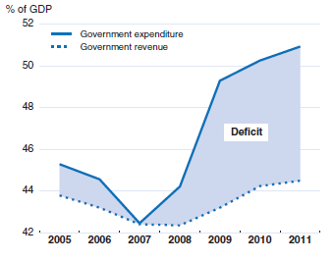
Continue fiscal consolidation
Source: OECD Economic Outlook 91 database.
Key challenges for Slovenia
40
Notes:
40

Slide 41
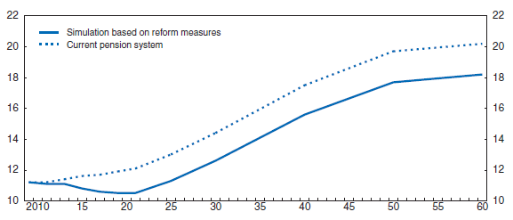
Reform the pension system
Impact of the failed pension reform on public expenditure, per cent of GDP
Source: M. Čok, J. Sambt and B. Majcen (2010), “Financial Implications of the Proposed Reforms”, Report of the Faculty
of Economics, University of Ljubljana.
Key challenges for Slovenia
41
Notes:
41

Slide 42
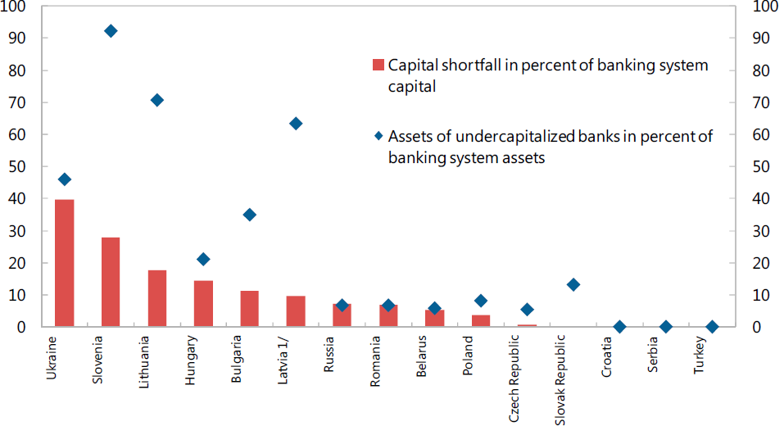
Recapitalize the banking sector
Banks with CAR<8 per cent after complete write-off of impaired loans
Source: European Banking Coordination “Vienna” Initiative, Working Group on NPLs in Central, Eastern and Southeastern Europe, March 2012.
Key challenges for Slovenia
42
Notes:
42

Slide 43
Reduce corporate leverage
1. Calculated as total liabilities less shares and other equity as a percentage of shares and other equity; non-consolidated data.
2. Total loans. The household sector includes non-profit institutions serving households.
Source: OECD (2012), OECD National Accounts Statistics and OECD Economic Outlook: Statistics and Projections (databases), June.
Key challenges for Slovenia
43
Notes:
43

Slide 44
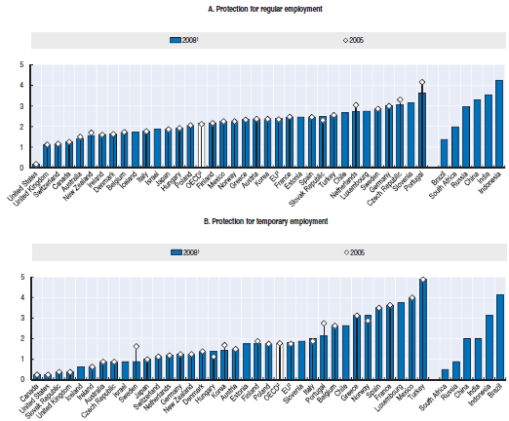
Tackle labour market dualism
Employment protection legislation, index of 0-6 from least to most restrictive
Source: Going for Growth (2012).
Key challenges for Slovenia
44
Notes:
44

Slide 45
Improve competitiveness
Export performance, 2000=100
1. Ratio between export volumes and export markets for total goods and services.
2. Thirteen euro area countries that are also OECD member countries, excluding Slovenia and Slovak Republic.
Source: OECD (2012), OECD Economic Outlook: Statistics and Projections (database), June.
Key challenges for Slovenia
45
Notes:
45

