Slide 1
Fiscal challenges in Slovenia
IMAD, Ljubljana, 19 June 2012
Mitja Košmrl, DG ECFIN

Slide 2
Outline
Recent public finance developments including the May 2012 austerity package
Structural challenges for public finances
Links between financial sector and public finances
Costs and benefits of fiscal consolidation

Slide 3
Slow fiscal consolidation until 2008 and then the crisis hit
Gradually improved budgetary position in run-up to EU entry
Indications of pro-cyclical fiscal policy over 2006-2008
Widening general government deficit to 6.1% of GDP in 2009

Slide 4
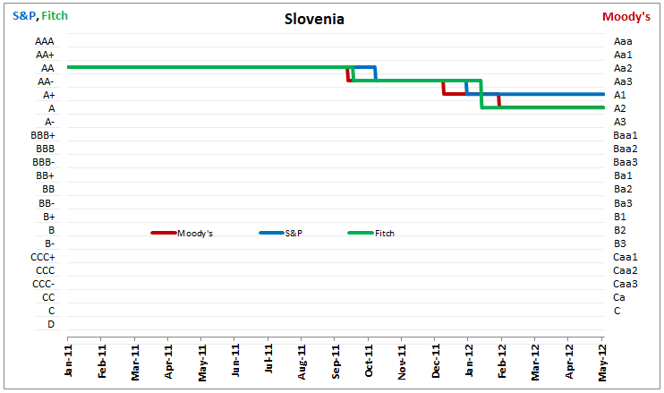
2011 brought sharp rise in spreads and sovereign downgrades
Missed deficit targets over 2010/11 with an average annual structural effort of only ¼% of GDP
Damaged credibility on financial markets
Sovereign ratings upgraded up to 2006, then stable, but successive downgrades followed since autumn 2011

Slide 5
Is the May 2012 austerity package the turning point?
Ambitious 2012 deficit target with an estimated structural fiscal effort of 2¼% of GDP, which is among the highest in euro area
First-ever planned cut in primary current expenditure
Final decision is taken on the package, hopefully also paving the way for successful negotiations of the social agreement 2012-2016

Slide 6
Many challenges remain
Risks to government revenue and expenditure projections in 2012 and beyond
Additional measures are likely to be needed for 2013 to ensure the correction of the excessive deficit
Many consolidation measures have expiry dates so they will need to be replaced with permanent ones
Public finance challenges of a more structural nature:
  Long-term sustainability
  Medium-term budgetary framework
  Risks from the financial sector

Slide 7
Structural challenge # 1: Long-term sustainability of public finances
Long-term cost of ageing is one of the highest in the EU (increase by 2060: SI 10.3% vs. EU 4.1% of GDP)
Based on current policies and projections the medium-term objective (MTO) of balanced structural position is not sufficiently demanding

Slide 8
Recommendations to Slovenia under the European semester
Commission asks that pension reform should:
  equalise the statutory retirement age for men and women
  raise the statutory retirement age in line with increasing life expectancy
  reduce early retirement possibilities, and
  review the indexation system for pensions

Slide 9
Structural challenge # 2: Medium-term budgetary framework (MTBF)
MTBF and expenditure rule are insufficiently binding and insufficiently focused on achieving sound medium-term budgetary position and securing long-term sustainability of public finances
The Fiscal Council does not yet weigh on fiscal strategy development
Uncertainty about the plans to adopt a constitutional debt rule
Recommendation to Slovenia under the European semester to strengthen the MTBF

Slide 10
Structural challenge # 3: Risks from the financial sector
2011: recapitalisations of NLB (impact on deficit: 0.7% of GDP) and NKBM
Second recapitalisation of NLB due by end-June
Uncertainty about budgetary impact of this and possible further recapitalisations for state-owned banks (the state as majority owner carries the burden of responsibility)
Possible need for further financial sector support also mentioned by rating agencies as reason for recent downgrades of sovereign ratings

Slide 11
Interlinkages between sovereign and banks (I)
In general, rising sovereign-risk premia, being to an extent a result of problems in the banking system, may spill back to the banking system through various channels:
  falling mark-to-market values of government bonds generate losses on the asset side
  lower values of government bonds impact negatively on banks' liquidity positions
  banks' funding costs increase due to a worsened access to funding on the liability side, and
  greater sovereign risks erode the potential for official support

Slide 12
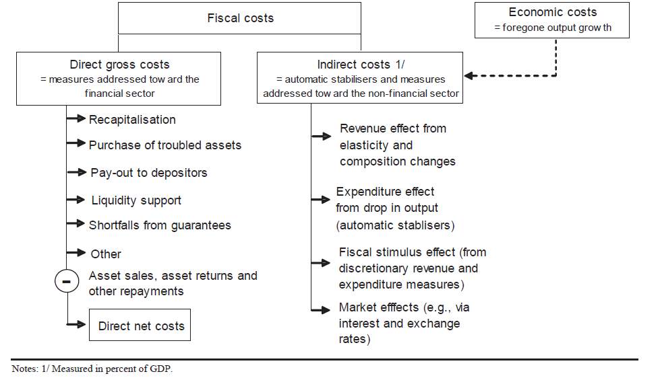
Interlinkages between sovereign and banks (II)

Slide 13
How to reduce fiscal costs?
Costs for the government depend ultimately on the seriousness of the situation in banks and on how accurately and quickly bank losses are assessed and acted upon
Direct fiscal costs are lower and recovery rates are higher when the bank resolution strategy is (Public Finance Report 2009):
  implemented swiftly and transparently
  underpinned by broad political support
  supported by strong public institutions and legal frameworks
  consistent in terms of fair and uniform treatment of market participants, and
  accompanied by a clear exit strategy

Slide 14
Recent sovereign CDS spreads
Strong correlation among sovereign and banks CDS spreads

Slide 15
Recommendations to Slovenia under the European semester
Take the required steps to build sufficient capital buffers in the banking sector and strongly promote the cleaning of balance sheets so that appropriate lending to productive activities can resume. Obtain fully-fledged third party verification of systemically important banks' stress loan-loss estimates
Improve the business environment through:
  establishing a framework for state-owned enterprises guaranteeing arms-length management and high standards of corporate governance, and
  improving bankruptcy procedures, in particular in terms of timeliness and efficiency

Slide 16
Short- and long-term impact of fiscal consolidation on the economy
Consolidation is likely to have negative employment and GDP effects in short run. Multiplier is around 0.3-0.4 for standardised 1% of GDP consolidation package
In the medium to long run funding costs for the private sector will be lower if sovereign risk is addressed, it leading to positive effects on investment, GDP and employment
These effects are strengthened by lower government interest payments, creating space for future tax reductions and more growth friendly expenditure

Slide 17
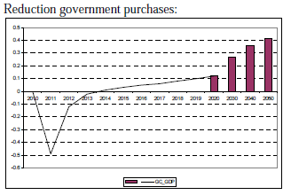
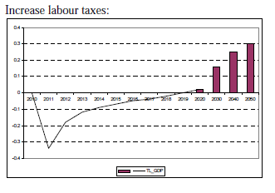
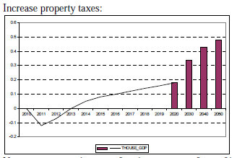
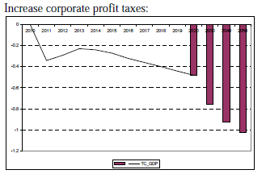
Quality of the consolidation effort matters
In general, the consolidation effort should be based on permanent measures and embedded in a credible medium- to long-term framework;
GDP losses can be minimised and long-run gains maximised with an appropriate policy mix.

Slide 18
Hvala.

